Slide 1
My design
Under the supervision of Instructor Ms. Amani Yassine

Slide 2
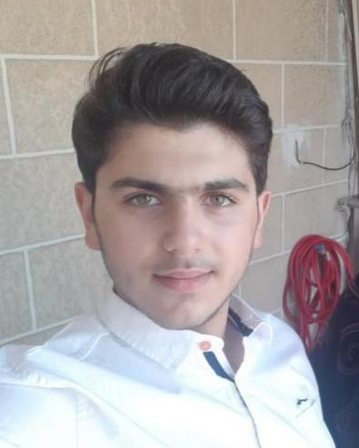
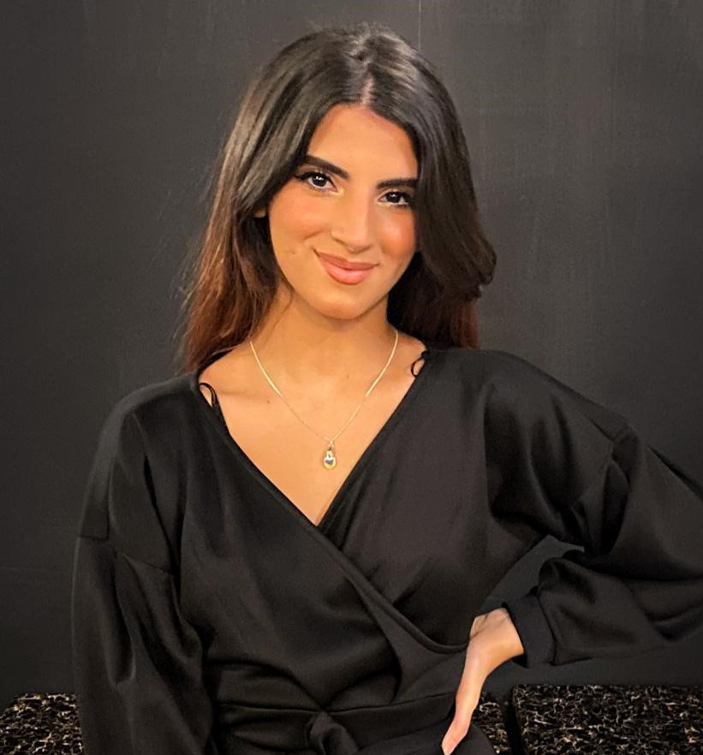
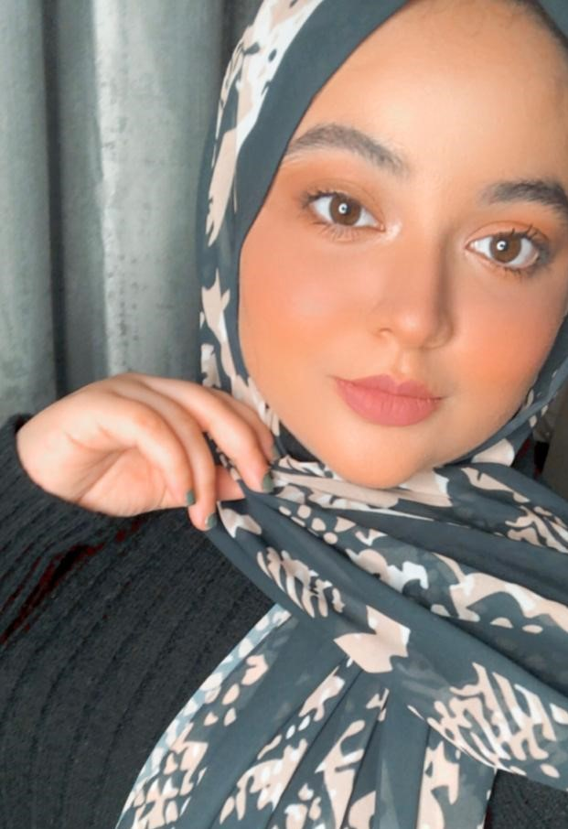
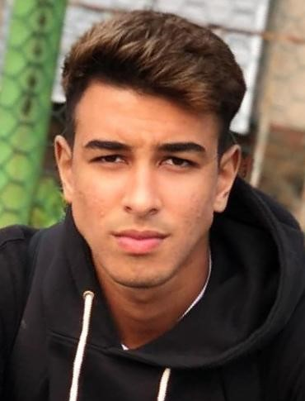
Our Team
Kassem Reda
Amal Salma
Nada Khaled
Khalid Kamal
College of business administration
College of media
College of design
College of media
The manager
Advertising and social media
The designer
politics

Slide 3
Our values
Honesty
Creativity
Being the best
Freedom
Personal development

Slide 4
About Us
Our purpose
our organization provide clothes depending on our customers choices.
Share self development and direct people how to be their selves and do not be a copy, and create a creative society.

Slide 5
Do you prefer to be unique?
Do you prefer to create your own design or have a ready design?
1
2
3
Will you support the company?

Slide 6
LOGO
SLOGAN
Do not, be a copy!!

Slide 7
Being popular and known locally.
gain customers trust.
have our own trademark in the market.
encourage people to deny being a copy.
Being known globally.

Slide 8
opportunities
strengths
. 1)Expand our company in attractive places and new territories. 2) Using social networks for advertising and gaining more customers. 3) Offer great communication skills with your employees and customer service. 4) Invest in newer technologies for production and services 5)Maintain the quality of our product | 1) Powerful attitudes among employees. 2) Personal interactions with the clients. 3) Improved customer services. 4) Customer satisfactions are our priorities. 5) Introducing unique collections

Slide 9
Thank you!
.
Email:
Phone:
Website:
Mydesign@gmail.com
04-555-0115
www.mydesign.ae

